Slide 1
BLOCKCHAIN FOR HEALTHCARE SYSTEMS

Slide 2
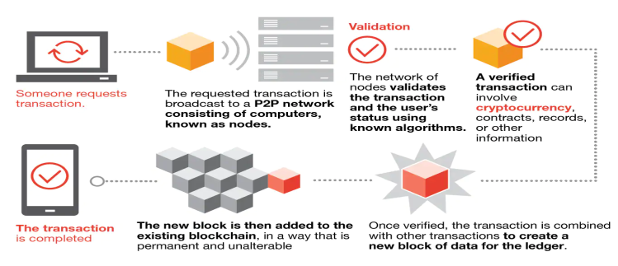
BLOCKCHAIN
Blockchain is defined as a distributed ledger technology that have an ever growing list of blocks that are linked together using cryptography.

Slide 3

Healthcare System
I have created a healthcare system over a blockchain in which patients can digitally update their symptoms and doctors can digitally update their prescription over the blockchain.

Slide 4

Methodology
Ethereum :- It is a open-source blockchain that provides us with smart-contract functionality.
I have used ethereum to make my healthcare system.

Slide 5
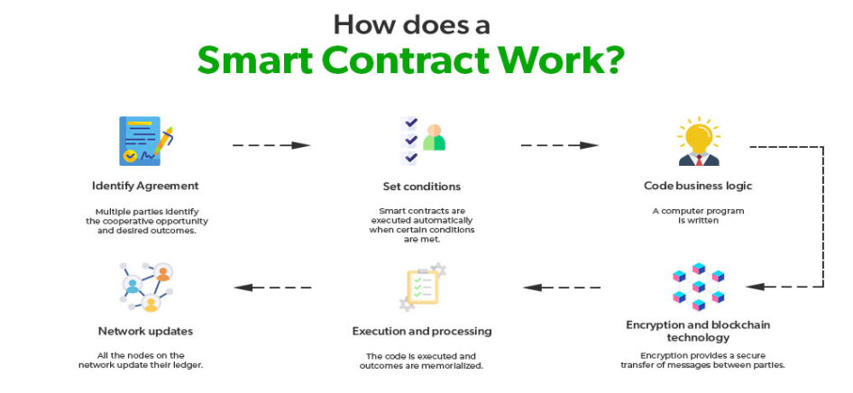
Smart-Contracts
Smart-Contracts are pieces of code that are stored on a blockchain and is executed when specific conditions are met.

Slide 6

Ganache
Ganache is a client side applications that allows us to locally host an ethereum blockchain.

Slide 7
Advantages
Privacy
Security
Faster compared to traditional database.

Slide 8
Disadvantages
Immutable
High development cost

